Slide 1
WEB 3, Session 1
Course
TypeScript

Slide 2
Ole Ildsgaard Hougaard
oih@via.dk
Computer Scientist (PhD)
Programming languages
Type systems
Industry experience
Uni-C
Educational Software, Games
Senior Developer
Acure / IBM
Healthcare solutions
Developer, architect, Scrum master
Google
V8 JavaScript Engine
VIA since 2009

Slide 3
Course
JavaScript/TypeScript on both the client and server side
In fact, almost exclusively TypeScript
Format: Lecture + work on course assignment
Few, if any other exercises.
I'll try to keep the lecture part to around 2 lessons, but no guarantees
6 course assignments
You'll implement an UNO game app in 2 different ways - each divided into 3 assignments
Exam
Oral, 20 minutes
You'll draw 2 assignments and discuss both them and the surrounding theory

Slide 4
Topics
Object-oriented TypeScript programming
Object-oriented GUI programming and State Management
Vue.js + Pinia
Client/Server programming
If time permits: Server-side rendering
Functional programming with Lodash
Functional state management with Redux
Server-side rendering with Next.js
Reactive programming with RxJS

Slide 5
How I code JavaScript/TypeScript
No semicolons 😲
Arrow functions
Spread and destructuring
map + filter + reduce
interface + object literal - avoiding this
Higher-order functions
Provider
Function

Slide 6
Arrow Functions
// Standard, I use this for larger functions:
function myFunction(x: number, y: number): number {
return x + x * y
}
// Arrow function, I use this for smaller functions
const myFunction = (x: number, y: number) => x + x * y

Slide 7
Spread
const numbers = [1, 2, 3]
const moreNumbers = [...numbers, 4] // [1, 2, 3, 4]
const point2D = {x: 75, y: 120}
const point3D = {...point2D, z: 80}
// {x: 75, y: 120, z: 80}

Slide 8
Destructuring arrays
const numbers = [1, 2, 3]
const [a, b, c] = numbers // a === 1, b === 2, c === 3
const [x, y] = numbers // x === 1, y === 2
const [i, j, k, l] = numbers // l === undefined
const [first, ...rest] = numbers
// first === 1, rest is [2, 3]

Slide 9
Destructuring objects
const point3D = {x: 75, y: 120, z: 80}
const {x, y} = point3D // x === 75, y === 120
const {z, ...point2D} = point3D
// z === 80, point2D is {x: 75, y: 120}
const x = 75, y = 120
const point2D = {x, y}

Slide 10
Map + filter + reduce
const salesRecord = [
{type: 'Dog food', amount: 2, price: 19.99},
{type: 'Cat food', amount: 2, price: 29.99},
{type: 'Dog food', amount: 1, price: 19.99},
{type: 'Fish food', amount: 2, price: 9.99},
]
const dogFoodRevenue = salesRecord
.filter(({type}) => type === 'Dog food') .map(({amount, price}) => amount * price) .reduce((sum, total) => sum + total, 0)

Slide 11
Interface + object literal
interface Counter {
next(): number
}
function counter(start: number = 0, step: number = 1): Counter {
let counter = start
const next = () => counter++
return { next }
}
const cnt = counter(1)

Slide 12
Provider
type Counter = () => number
function counter(start: number = 0, step: number = 1): Counter {
let counter = start
return () => counter++
}
const cnt = counter(1)

Slide 13
Function
function map<T, U>(ts: T[], f: (t: T) => U) {
const result: U[] = []
for(let t of ts) {
result.push(f(t))
}
}
let ns = [1, 2, 3]
let doubles = map(ns, x => 2 * x)
console.log(doubles) // [2, 4, 6]

Slide 14
TypeScript
const e = 8
const s = '7'
console.log(e * s)

Slide 15
any
const e: any = 8
const s: any = '7'
console.log(e * s)
// Note: function parameters are type any unless
// otherwise specified

Slide 16
Object type vs interface - What's the difference?
interface PointInterface {
x: number
y: number
z?: number
}
type PointType = {
x: number
y: number
z?: number
}

Slide 17
Why is this legal?
type Point = {x: number, y: number}
const distanceFromOrigin = (p: Point) => Math.sqrt(p.x * p.x + p.y * p.y)
const p = {
x: 20,
y: 35,
unit: 'px'
}
const dist = distanceFromOrigin(p)

Slide 18
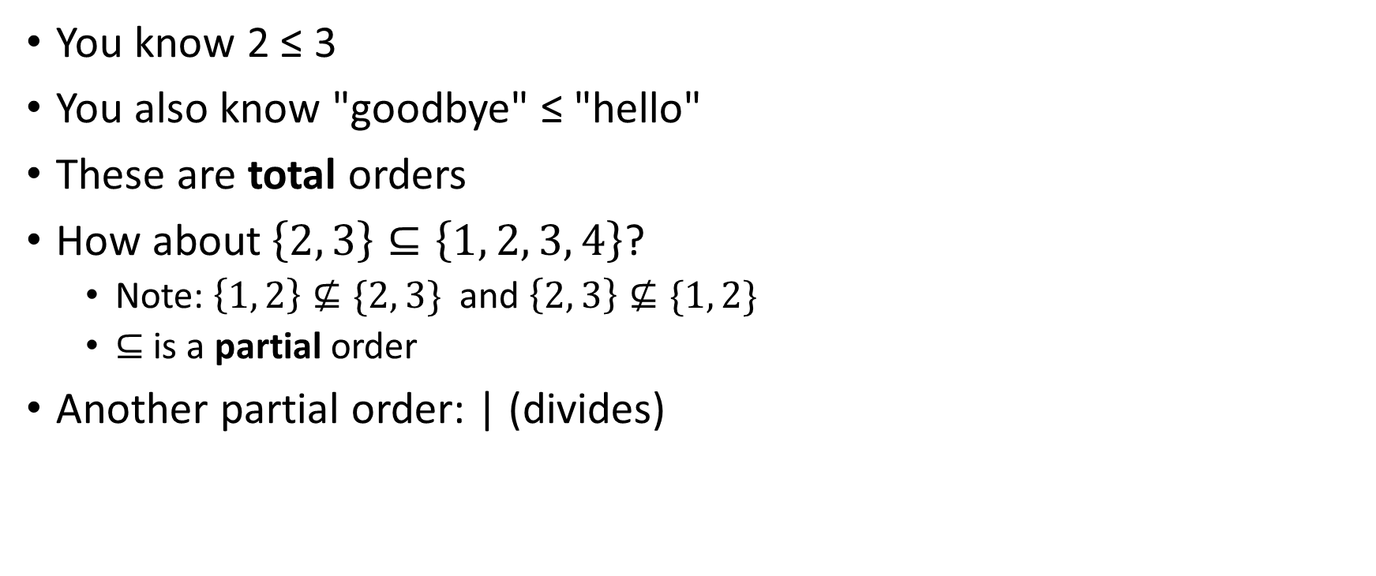
Ordering
You know 2 ≤ 3
You also know "goodbye" ≤ "hello"
These are total orders
How about$\left\{2, 3\right\}⊆\left\{1, 2, 3, 4\right\}$?
Note: $\left\{1, 2\right\}⊈\{2, 3\}$ and $\left\{2, 3\right\}⊈\{1, 2\}$
$⊆$ is a partial order
Another partial order: | (divides)

Slide 19
Subtype ordering
The more general type is considered larger.
{ x: number, y: number } <: { x: number }
{ x: number, z: string } <: { x: number }
{ x: number, z: string } and { x: number, y: number } are unrelated

Slide 20
Type lattice

Slide 21
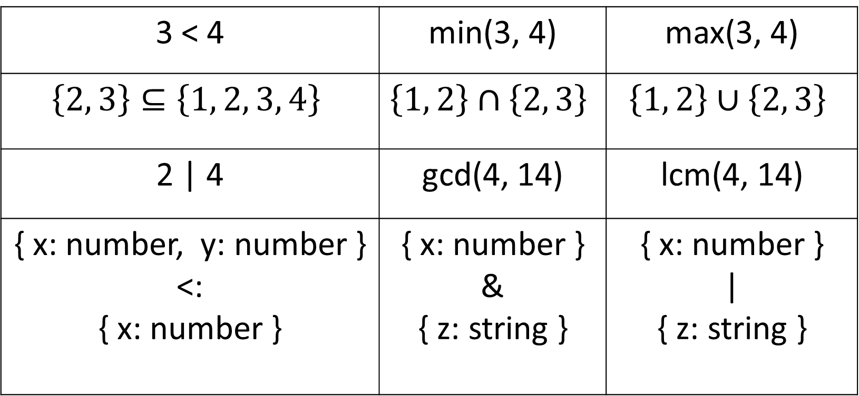
Subtype properties
3 < 4 | min(3, 4) | max(3, 4)
$$\left\{2, 3\right\}⊆\left\{1, 2, 3, 4\right\}$$ | $$\left\{1, 2\right\}∩\left\{2, 3\right\}$$ | $$\left\{1, 2\right\}∪\left\{2, 3\right\}$$
2 | 4 | gcd(4, 14) | lcm(4, 14)
{ x: number, y: number } <: { x: number } | { x: number } & { z: string } | { x: number } | { z: string }

Slide 22
Intersection types
type Point = {x: number, y: number}
type Measurable = {unit: 'px' | 'pt' | 'cm' | 'in'}
const p: Point = {x: 100, y: 200}
const m: Measurable = {unit: 'px'}
const screenPoint: Point & Measurable = {...p, ...m}

Slide 23
Narrowing
function double(n: number | undefined) {
if (n === undefined) {
return undefined
}
return n * 2
}

Slide 24
Narrowing problem
type LoadingState = { percentComplete: number }
type FailedState = { statusCode : number }
type OkState = { payload: number[] }
type State = LoadingState | FailedState | OkState
function reportState(state: State) {
if (state.percentComplete !== undefined) {
console.log(`Loading ${state.percentComplete}% done`)
} // And so on
}

Slide 25
Discriminated Unions
type LoadingState = { status: 'loading', percentComplete: number }
type FailedState = { status: 'failed', statusCode : number }
type OkState = { status: 'ok', payload: number[] }
type State = LoadingState | FailedState | OkState
function reportState(state: State) {
if (state.status === 'loading') {
console.log(`Loading ${state.percentComplete}% done`)
} // And so on
}

Slide 26
Subsets of discriminated unions
type LoadingState = { status: 'loading', percentComplete: number }
type FailedState = { status: 'failed', statusCode : number }
type OkState = { status: 'ok', payload: number[] }
type State = LoadingState | FailedState | OkState
type FinishedState = State & { status: 'failed' | 'ok' }

Slide 27
Working out the type

Slide 28
Extracting types from object types
type LoadingState = { status: 'loading', percentComplete: number }
type FailedState = { status: 'failed', statusCode : number }
type OkState = { status: 'ok', payload: number[] }
type State = LoadingState | FailedState | OkState
type FinishedState = State & {
status: FailedState['status'] | OkState['status']
}

Slide 29
What is the status type?
type LoadingState = { status: 'loading', percentComplete: number }
type FailedState = { status: 'failed', statusCode : number }
type OkState = { status: 'ok', payload: number[] }
type State = LoadingState | FailedState | OkState
type Status = State['status']

Slide 30
Course Assignment

